Slide 1
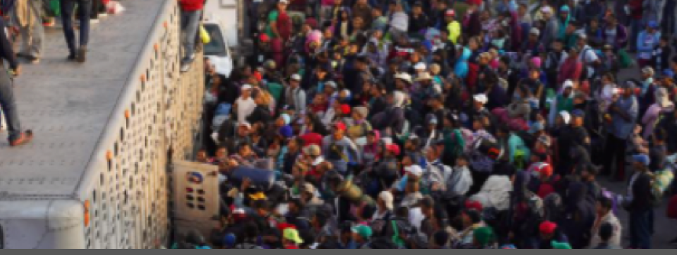
Migrant Health Crisis in Tijuana, Mexico
Jose Luis Burgos, M.D., M.P.H.
UCSD School of Medicine
Notes:
JL Burgos: health implications of the journey and the conditions in the shelters

Slide 2
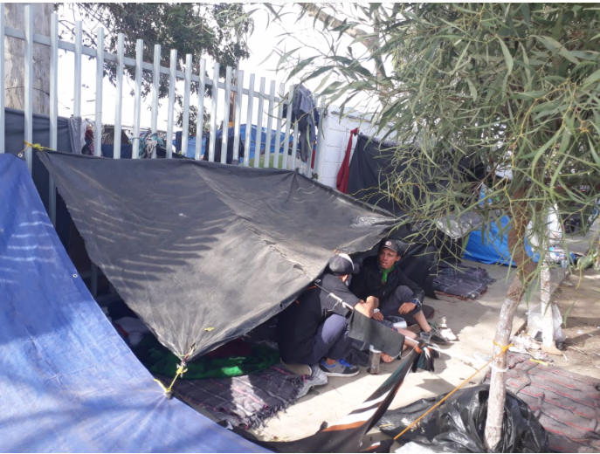
Outline
JL Burgos: health implications of the journey and the conditions in the shelters

Slide 3
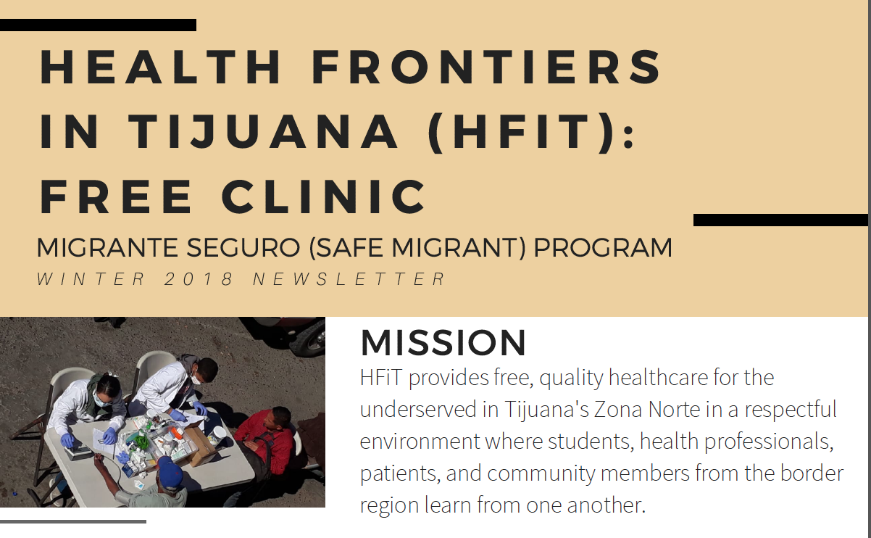
HFiT Clinic and Migrant Health

Slide 4
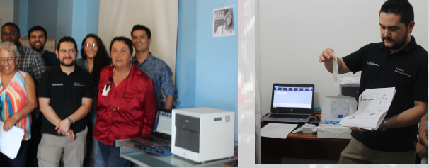
Innovations and new services
With the Support from the Elton John AIDS Foundation, the HFiT Clinic can provide rapid HIV viral loads in 2 hours for indigent migrants

Slide 5
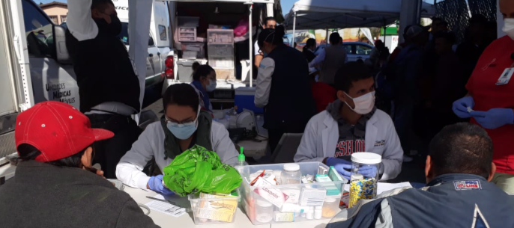
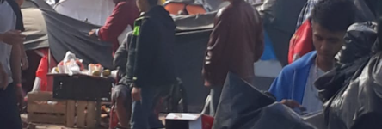
Health problems among migrants
The HFiT program has provided medical care to more than 150 migrants from the Migrant Caravan since November of 2018.
Most common complains are upper respiratory tract infections, mental health issues, skin disorders
There is concern about TB due to living conditions
Many migrants from the LGBTQI are fleeing violence and transphobia.

Slide 6
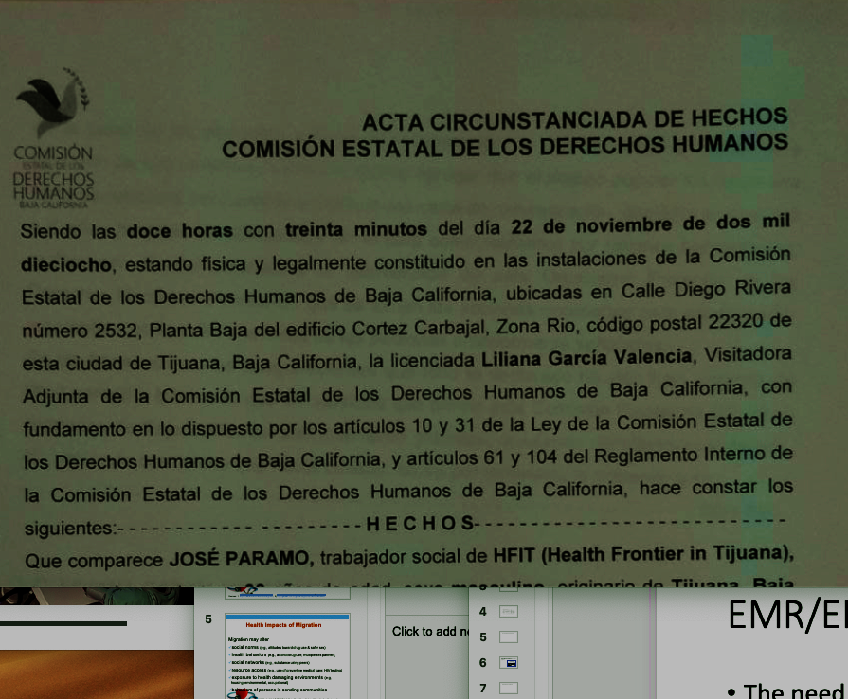
The current Central American Caravan is facing barriers to access medical services
To access medical services for chronic diseases or tertiary care, migrants have to request help from human rights agencies and Federal public courts.
“…ya sea por medio de quejas o amparos, para que se les respeten las garantías individuales de la carta magna o los derechos que tiene la ley federal de migración contemplado en los artículos correspondientes para su estancia digna dentro del territorio mexicano.”
Jose Paramo,
HFiT Migrant Legal Advisor

Slide 7
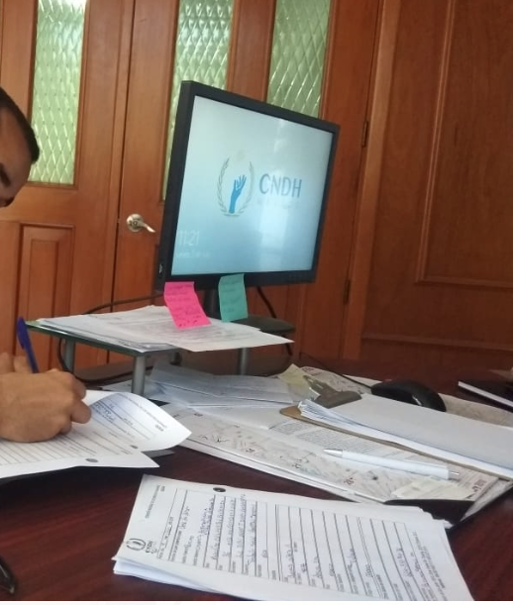
Seguro Popular for Migrants
In November central and south American migrants were denied access to Seguro Popular
After formal complains were submitted to the Mexican Human Rights Commission (CNDH) Migrants were provided Temporary Seguro Popular without an option for renewal
Formal complains have been submitted to the CNDH and Federal Courts in Mexico to ensure continuity of care for migrants

Slide 8

Case story: FR
FR is a 23 year old transgender woman from a rural community in Honduras.
She received death threats from a local gang and from other sex workers in her home town after a health brigade performed HIV tests in her community. The results of her HIV test were not kept confidential
She left Honduras earlier this year and moved to Mexico
FR worked at flee markets and occasionally as a sex worker to survive.

Slide 9

HIV Care
FR was seen at an HIV clinic in Mexico City and her viral load became undetectable
She started receiving death threats from members of a cartel with ties to the gangs back home and was stabbed near the subway station in Tlalpan
  “Ya te encontramos condenada, ya valiste…”
Her temporary Seguro popular expired in October and was taken off ARVs
FR arrived in Tijuana November 7 of this year.

Slide 10
Seeking safety
FR does not feel safe in Mexico and is concerned about transphobia and growing xenophobia in Mexico
She is seeking refuge in the U.S. to escape violence and to continue on her ARV therapy but she has been told that she will need to wait several months before she can apply for Asylum
FR cannot get a job and does not want to become homeless
She has lost weight and her viral load is log 2.2

Slide 11
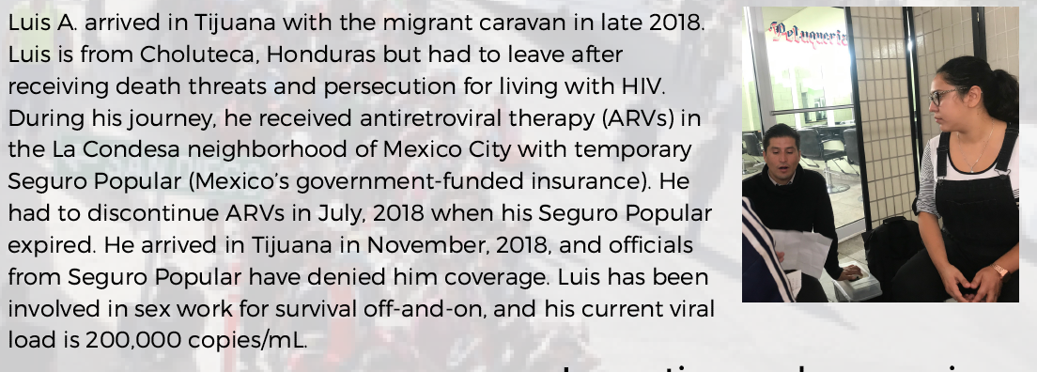
Case Story2 : Luis

Slide 12

Migrant Health Crisis
Research is needed to evaluate the impact from U.S. migration policy and migrant receiving communities
Access to health care services for Migrants are critical for public Health
Collaboration across borders is necessary to properly address the current crisis
Longitudinal research on public health and human rights issues around migration is necessary

