Slide 1
Tijuana River Watershed Tour
Frontera Friday, January 25, 2019

Slide 2
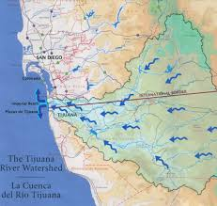
MINUTE 320
Sediment
Solid Waste
Water Quality
Issues: Flood Control Wastewater Discharge
Climate Change Impacts
Solid waste disposal
Integrated Sustainable Management

Slide 3
TRW Stakeholders
Academic researchers
Active from 1980s
Significant joint research with Mexican scholars
Publication of two atlases (2000, 2005), research reports, journal articles
Applied research and outreach
Diverse stakeholders from both countries
Vision project—conceptual watershed management plan (2005)
Programa de Manejo Integral de Agua en la Cuenca del Rio Tijuana (2017)
Support integrated, binational watershed management; framework in new minute

Slide 4
Regional Governance: TRW
Complicated public administration
San Diego County, City of San Diego, City of Imperial Beach
Many state and federal agencies administer land in watershed
No coordinated policy among U.S. entities
4 U.S. tribal reservations; 2 indigenous areas in Mexico
International boundary
3 Mexican municipalities plus state, federal agencies
International agencies, International Boundary and Water Commission/Comision de Limites y Aguas

